Slide 1

Murtaza Hunaid (Leader)
Turab Ali Zaidi
Adnan Hatim
Taymoor Ahson

Slide 2
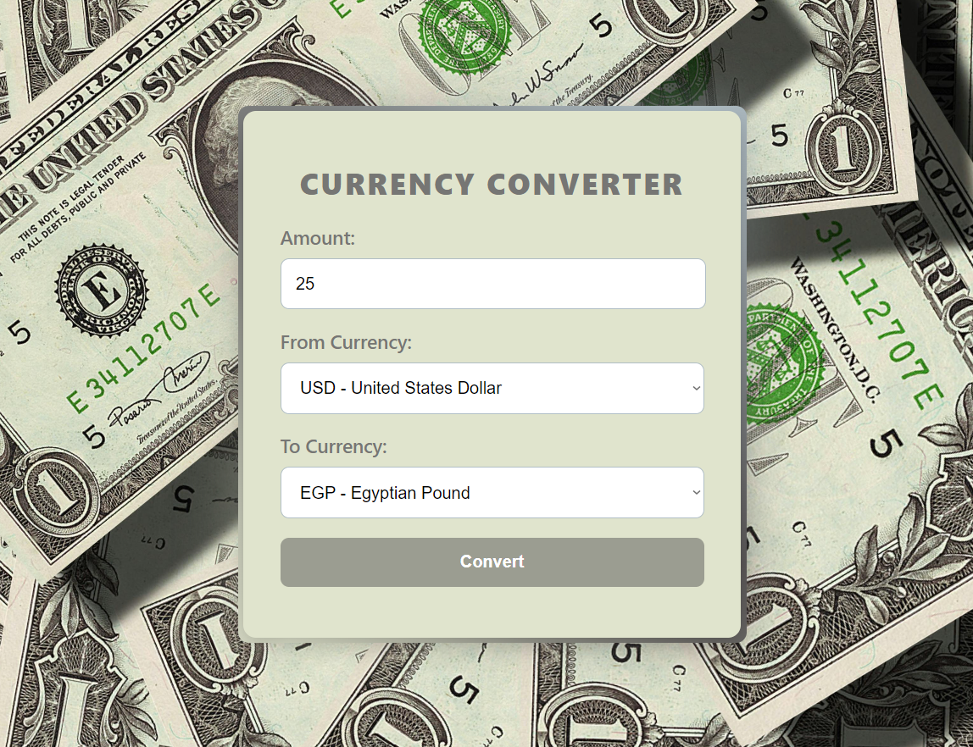
WHAT WE OFFER
The Currency Converter simplifies currency exchange by allowing users to input an amount and select two currencies - one to convert from and one to convert to. The website then calculates the equivalent value based on real-time exchange rates.

Slide 3
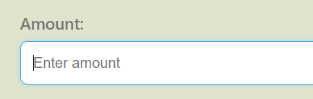
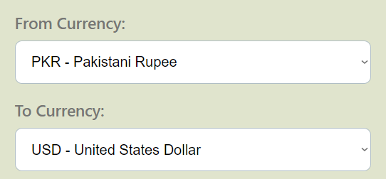
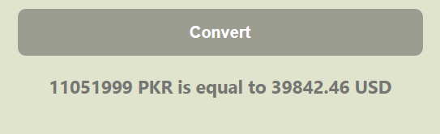
The Currency Converter allows users to input an integer value as an amount →
←The users can then choose the currencies they wish to convert between
A simple click on the “Convert” button will display the requested result →

Slide 4
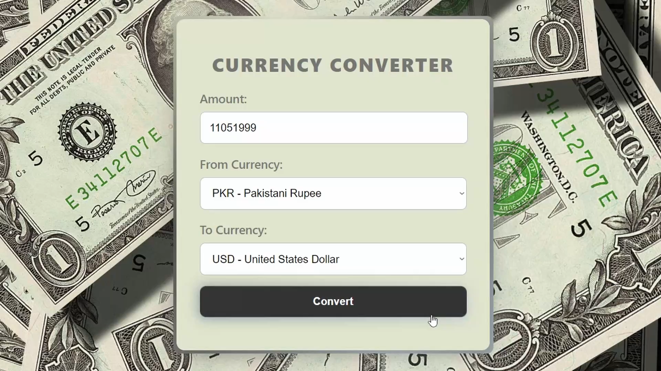

Slide 5

HOW THE CODE WORKS
The website is built using three separate components of code, written in HTML, CSS and JavaScript.
The HTML part focuses on the basic structure of the currency website, defining the page layout, and including different elements like input fields, dropdowns, and a button for the users to enter the amount and select the currency to convert.

Slide 6
The JavaScript portion is the functional core of the currency converter, processing the main conversion. It fetches a list of supported currencies and populates the dropdown menus for "From Currency" and "To Currency.“ It then processes the conversion, retrieving the input amount and currency, validating and fetching the exchange rates from the ExchangeRate API and displays the calculated amount. It also provides user-friendly messages in case of an error.
The CSS segment styles the website with an appealing and user-friendly interface, allowing for the inclusion of interactive elements, an overall professional look as well as styling key elements.

Slide 7


